Slide 1
Intelligent Banking
Transaction Processing
ACID Compliance, Fraud Detection
and Performance Tuning
Sinchana B Kurkuri (24BDS0352)
Prachi Pandurang Raddi (24BDS0389)
B. Tech CSE (Data Science)
School of Computer Science and Engineering
Vellore Institute of Technology, Vellore
Project guide: Dr. Nithya N S Academic year: 2026–27
SENTINEL / DBMS PROJECT
01
Notes:
Team and institution details follow the supplied final report title page. Introduce this as a local educational MySQL banking laboratory. All demonstration identities are synthetic. Source: docs/FINAL_PROJECT_REPORT.docx, identical to the supplied Downloads copy.

Slide 2
Abstract and problem statement
A banking action must leave a correct, explainable database state
Abstract
Problem
A MySQL banking laboratory connects financial operations, automatic fraud evaluation and an attributable audit trail.
Partial transfers, lost updates and unexplained balance changes can make a simple CRUD banking application unreliable.
Approach
Public stored procedures own financial changes. Constraints, locks and triggers enforce the rules. Reconciliation checks the resulting state.
SENTINEL / DBMS PROJECT
02
Notes:
Explain a transfer as debit plus credit. A successful button click is insufficient if the database ends in an inconsistent state. Our implementation makes both the operation and its verification observable.
Sources: docs/FINAL_PROJECT_REPORT.docx; docs/FINAL_PROJECT_REPORT.md

Slide 3
Objectives and scope
Objective | Implemented scope
Correct banking operations | Customers, accounts, deposits, withdrawals, transfers, loans and approvals
Consistency and concurrency | Ledger reconciliation, ordered row locks, rollback and retry
Fraud and accountability | Configured rules, flag review, session attribution and audit JSON
Observable demonstration | Local dashboard, SQL tests, browser workflow and evidence
Scope boundaries | Single owner per account, one currency and synthetic identities
Educational localhost demonstration. No real payment network or production banking deployment.
SENTINEL / DBMS PROJECT
03
Notes:
Distinguish database workflows from dashboard forms. Loan and approval routines exist in the database and CLI, while the web UI focuses on the documented financial and review actions.
Sources: docs/FINAL_PROJECT_REPORT.docx; docs/FINAL_PROJECT_REPORT.md

Slide 4
System architecture and workflow
The browser delegates financial logic to MySQL
Browser
Python server
Native client
MySQL InnoDB
HTML / CSS / JavaScript
Fixed HTTP endpoints
External option file
Public banking procedures
Within the transaction
Separate evidence path
Account locks and ledger writes trigger audit recording and fraud evaluation.
Historical experiments and timings remain labeled separately from live MySQL data.
SENTINEL / DBMS PROJECT
04
Notes:
Walk through a deposit from the browser to the public procedure, then through audit and fraud triggers. Credentials stay outside Git. The server binds to loopback, validates requests and checks the owned database marker. Source: demo/dashboard.py and demo/bank_cli.py.
Sources: docs/FINAL_PROJECT_REPORT.docx; docs/FINAL_PROJECT_REPORT.md

Slide 5
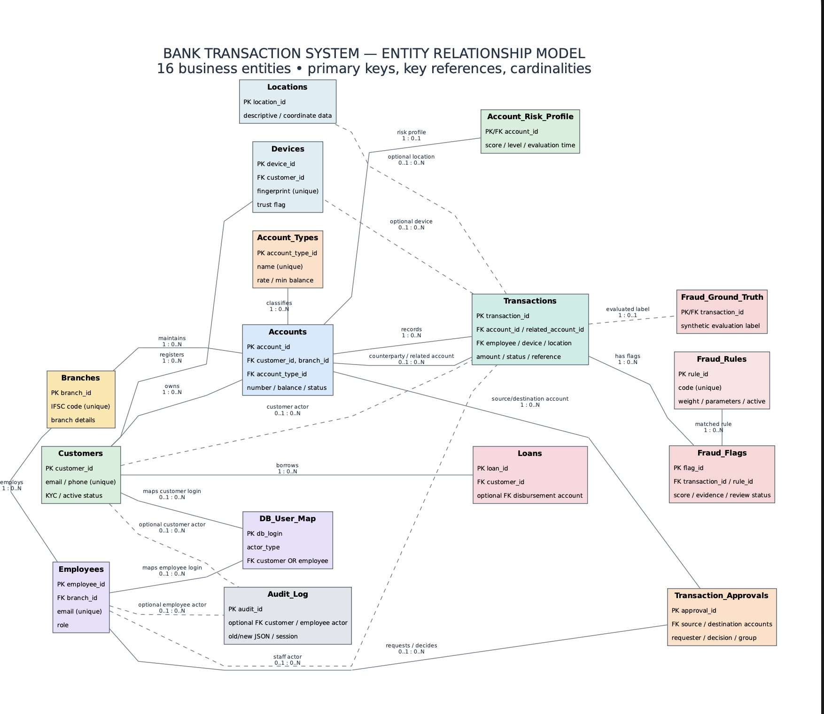
ER diagram
Revised report model
16 business entities
Primary keys and foreign keys
Required and optional relationships
The detailed labels are available in Figure 2 of the report.
SENTINEL / DBMS PROJECT
05
Notes:
Revised Figure 2 reproduced unchanged from the supplied report. Describe banking ownership, transactions, loan disbursement, device and location references, fraud flags and rules, risk profiles, ground-truth labels, audit actors and identity mapping. The source figure groups certain account and staff references. The SQL defines 26 separate FKs. Audit_Log.table_name/record_pk is not a generic FK. View the report at full size for individual labels. Source: docs/FINAL_PROJECT_REPORT.docx, Figure 2.

Slide 6
Relational schema and normalization
Relations | Purpose and normalization choice
Branches, Employees, Customers, Account_Types | Store master facts once, link records through keys
Accounts, Transactions, Loans | Separate ownership, ledger events and borrowing
Devices, Locations, Fraud_Rules | Separate device identity, geography and rule configuration
Fraud_Flags, Account_Risk_Profile, Fraud_Ground_Truth | Separate observed flags, summary state and evaluation labels
DB_User_Map, Transaction_Approvals, Audit_Log | Separate identity mapping, approval lifecycle and history
Normalization principles
1NF: atomic attributes. 2NF: no partial key dependency. 3NF: master facts stay in their own relations.
Balances, risk summaries and JSON are deliberate derived or historical state, checked through reconciliation.
SENTINEL / DBMS PROJECT
06
Notes:
Use 1NF as atomic named attributes and no repeating account groups. Separate descriptive master data reduces update anomalies. Do not claim every derived attribute is an independent 3NF fact: balances, risk summaries and JSON evidence are intentional design choices.
Sources: docs/FINAL_PROJECT_REPORT.docx; docs/FINAL_PROJECT_REPORT.md

Slide 7
Database implementation and constraints
MySQL 8.4.11, InnoDB and utf8mb4
CREATE TABLE Accounts (
account_id INT AUTO_INCREMENT,
customer_id INT NOT NULL, branch_id INT NOT NULL,
account_type_id INT NOT NULL,
account_number VARCHAR(20) NOT NULL,
balance DECIMAL(14,2) NOT NULL,
status ENUM('Active','Frozen','Closed')
NOT NULL DEFAULT 'Active',
opened_date DATE NOT NULL,
CONSTRAINT pk_accounts PRIMARY KEY(account_id),
CONSTRAINT uq_accounts_number UNIQUE(account_number),
CONSTRAINT chk_accounts_balance CHECK(balance>=0)
) ENGINE=InnoDB DEFAULT CHARSET=utf8mb4;
Constraint layers
PK: unique row identity
FK: referenced row exists
UNIQUE: no repeated identifiers
NOT NULL: required values
CHECK: valid amounts and state
ALTER TABLE Accounts ADD CONSTRAINT fk_accounts_customer_id
FOREIGN KEY (customer_id) REFERENCES Customers(customer_id);
Full FK definitions also specify ON DELETE RESTRICT and ON UPDATE RESTRICT.
SENTINEL / DBMS PROJECT
07
Notes:
Read the exact Accounts DDL excerpt. All columns are real. Core FKs use ON DELETE RESTRICT and ON UPDATE RESTRICT. Cross-table minimum balance needs a trigger/procedure because a row CHECK cannot query Account_Types.
Sources: schema/01_tables/05_accounts.sql; schema/02_constraints/01_core_constraints.sql

Slide 8
Sample records, queries and outputs
Synthetic reference data and a recorded workflow
INSERT INTO Account_Types
(type_name,interest_rate,min_balance) VALUES
('Savings',3.50,1000.00),
('Current',0.00,5000.00),
('Fixed Deposit',6.50,10000.00)
ON DUPLICATE KEY UPDATE
interest_rate=VALUES(interest_rate),
min_balance=VALUES(min_balance);
SELECT type_name,interest_rate,min_balance
FROM Account_Types;
Type | Rate % | Minimum
Savings | 3.50 | 1,000.00
Current | 0.00 | 5,000.00
Fixed Deposit | 6.50 | 10,000.00
Recorded HTTP workflow
20,000 opening deposit
+100 deposit −25 withdrawal −50 transfer
Final balance: 20,025.00
SENTINEL / DBMS PROJECT
08
Notes:
The INSERT is the source reference seed. The SELECT table shows the seeded values rather than a newly executed query. The arithmetic is the recorded real MySQL HTTP workflow from 20 October 2026, before the additional suspicious deposit. Production banking mutations use procedures rather than direct balance INSERT/UPDATE.
Sources: data/seed/01_reference_data.sql; docs/FINAL_PROJECT_REPORT.md section 22; evidence/reviews/final-dashboard/REPORT.md

Slide 9
Advanced database concepts
Concept | Implementation | Example
Stored procedures | Validation, locks and transaction ownership | sp_open_account, sp_transfer_funds
Functions | Reusable balance, reference and risk calculations | fn_available_balance, fn_txn_risk_score
Guard triggers | Minimum balance, device ownership, immutability | trg_transactions_bu_immutable
Audit and fraud triggers | Automatic transactional side effects | Audit INSERT before fraud evaluation
Views | Selected columns and identity-aware reads | v_customer_account_summary
Transaction control | Commit a complete operation or roll it back | START TRANSACTION / COMMIT / ROLLBACK
Public routines use SQL SECURITY DEFINER. Private sp_internal_* helpers are outside the role EXECUTE list.
SENTINEL / DBMS PROJECT
09
Notes:
Explain stored procedures as the banking API. Audit triggers call sp_resolve_actor(USER()) and record old/new JSON. The fraud AFTER INSERT trigger follows trg_transactions_ai_audit. Guards reject ledger and audit UPDATE/DELETE. Views also include v_transaction_activity and v_fraud_case_queue.
Sources: docs/FINAL_PROJECT_REPORT.docx; docs/FINAL_PROJECT_REPORT.md

Slide 10
Transaction control and ACID
A transfer is one atomic database operation
01
Lock
Acquire account rows in account-ID order
02
Debit
Update sender and record TransferOut
03
Credit
Update receiver and record TransferIn
04
Commit
Persist both legs and their trigger effects
Any exception triggers ROLLBACK. The 5016 test deliberately fails after debit and verifies identical before/after state.
SENTINEL / DBMS PROJECT
10
Notes:
Atomicity comes from public transaction handlers. Consistency comes from constraints plus six invariants. Isolation uses row locks and deterministic ordering with no preliminary shared existence lookup. Durability is conditional on InnoDB configuration. A process/power crash is not demonstrated by this rollback probe. Audit rows and fraud flags roll back with the banking operation. Eligible business errors can create a separate Failed row after rollback.
Sources: procedures/sp_internal_post_transfer.sql; procedures/sp_transfer_funds.sql; docs/FINAL_PROJECT_REPORT.md section 12

Slide 11
Fraud scoring and automatic evaluation
Configured rules flag activity for review without blocking the transfer
Signal | Condition | Added catalog weight
HIGH_AMOUNT | Amount ≥ 5,000 | 20
UNTRUSTED_DEVICE | Device missing or untrusted | 20
DIGITAL_CHANNEL | Online or Mobile | 10
HIGH_ACCOUNT_RISK | Accumulated transaction-local score ≥ 60 | 25
RAPID_ACTIVITY | At least 3 Completed transactions in 10 min | 25
Helper probe: untrusted +20 and digital +10 = 30
The evaluator adds matched rule weights separately and caps risk at 100. Reevaluation uses the same transaction facts.
SENTINEL / DBMS PROJECT
11
Notes:
Avoid confusing helper score 30 with final catalog score. The controlled suspicious workflow reached 100 with multiple rules, but the current dataset determines the result. HIGH_ACCOUNT_RISK uses accumulated transaction-local score to avoid feedback from stored account risk. Seven functions cover distance, z-score, count window, odd hour, account age, score and level. Distance and odd-hour helpers do not imply active seeded rules.
Sources: docs/FINAL_PROJECT_REPORT.docx; docs/FINAL_PROJECT_REPORT.md

Slide 12
Audit, views and access control
Audit evidence
Role design
Nine audit triggers cover Accounts, Transactions and Loans. JSON captures old/new values with the session USER() and resolved actor.
Customer, Teller, Manager and Auditor roles have different view and public-procedure permissions. Customer ownership and staff branch checks apply.
Demonstration boundary
The web dashboard uses a privileged local connection. It does not authenticate customers or impersonate staff roles.
Audit coverage begins at its install watermark. A privileged DBA can bypass trigger-based protections.
SENTINEL / DBMS PROJECT
12
Notes:
Explain USER versus CURRENT_USER in DEFINER execution. Identity-filtered views and procedure checks are separate from fresh restricted-login certification. The report leaves that certification pending. Manager does not automatically get Audit_Log SELECT. Audit triggers reject ordinary updates/deletes, but do not defeat a DBA who drops triggers or truncates tables.
Sources: security/README.md; views/*.sql; procedures/sp_generate_statement.sql; docs/FINAL_PROJECT_REPORT.md section 17

Slide 13
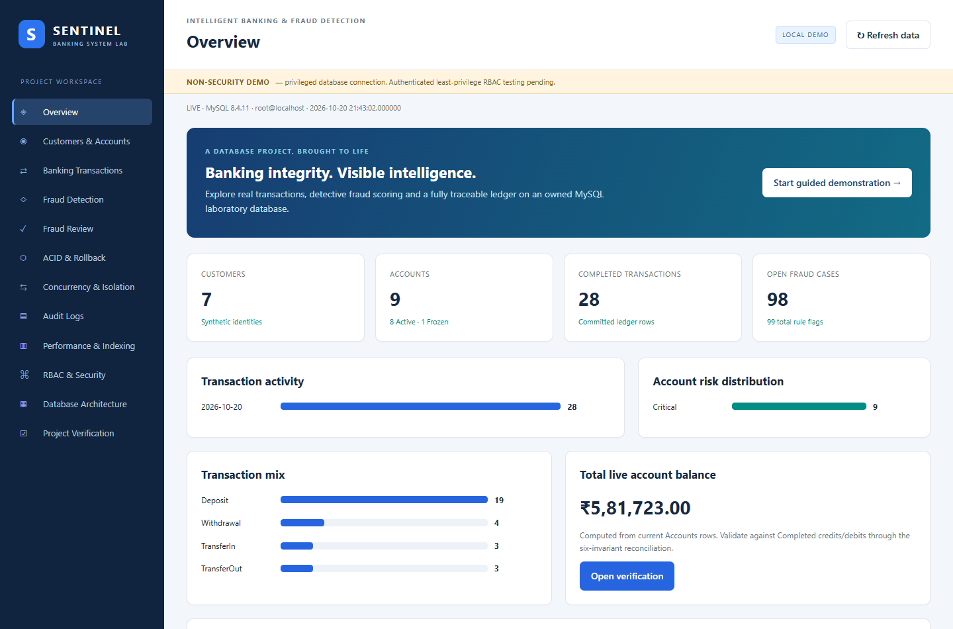
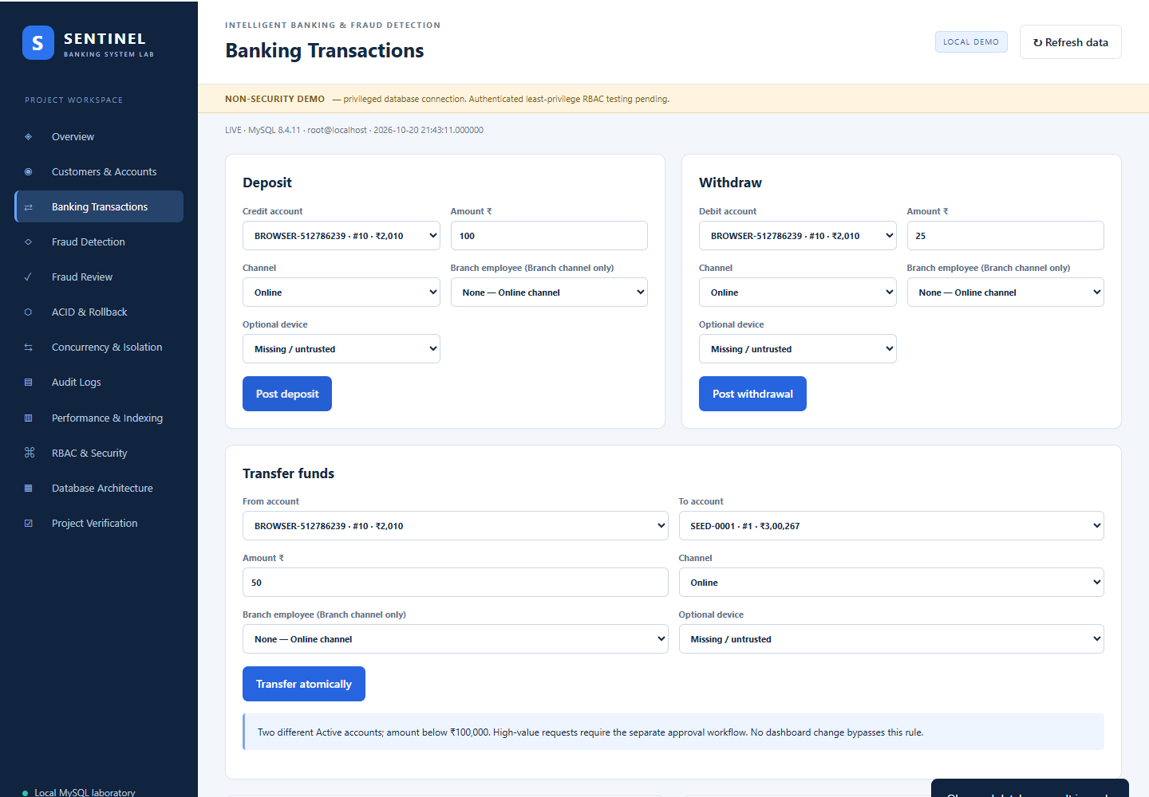
Application demonstration: banking
Actual Edge screenshots from 20 October 2026
Overview and live bank summary
Deposit, withdrawal, transfer and statements
SENTINEL / DBMS PROJECT
13
Notes:
Live presentation: open http://127.0.0.1:5000 through the running Python backend, not file://index.html. Register a synthetic customer and open an account, copying actual returned IDs. Deposit 100, withdraw 25 and transfer 50. Generate today’s statement and inspect the ledger. Screenshots show selected upper sections of original full-page captures.
Sources: docs/FINAL_PROJECT_REPORT.docx; docs/FINAL_PROJECT_REPORT.md

Slide 14
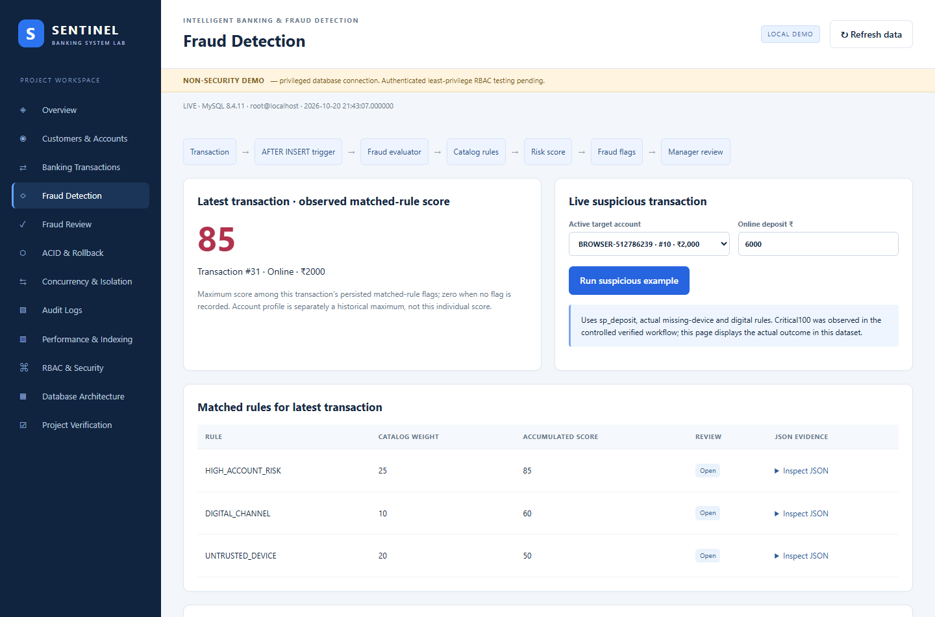
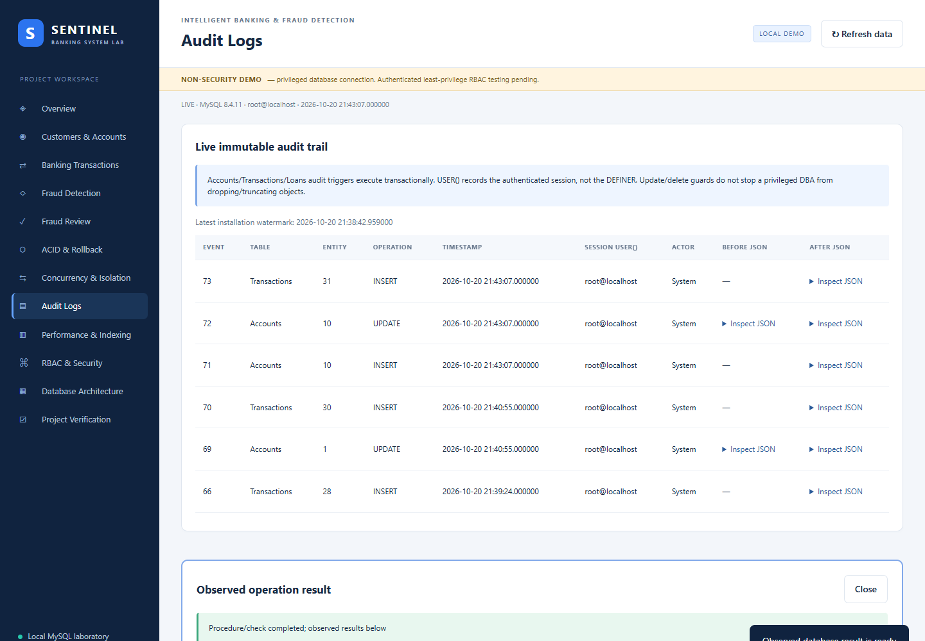
Application demonstration: fraud and audit
Actual Edge screenshots from the connected demonstration database
Matched rules and persisted evidence
Session identity and JSON change history
SENTINEL / DBMS PROJECT
14
Notes:
Run the suspicious Online deposit using the provided action. Inspect actual matched rules and JSON. Review an Open flag through UnderReview then Confirmed or Dismissed. Inspect audit entries for the banking action. Review is a manager procedure operation, but the dashboard connection is still privileged. The images are cropped for readability without alteration of source evidence.
Sources: docs/FINAL_PROJECT_REPORT.docx; docs/FINAL_PROJECT_REPORT.md

Slide 15
Testing and results
Recorded final-demo populations, 20 October 2026
Test population | PASS | FAIL | Evidence type
Standalone SQL | 632 | 0 | Historical SQL suite
Integrated A+B SQL | 688 | 0 | Historical SQL suite
CLI workflow | 41 | 0 | Real MySQL workflow
ERROR 1222 seed regression | 25 | 0 | Opening-account trigger chain
HTTP boundary tests | 9 | 0 | Request validation tests
Real MySQL HTTP workflow | 32 | 0 | Database-backed API checks
Extended browser workflow | 23 | 0 | Installed Edge interaction
Populations overlap and must not be added. These are retained measurements, not new test executions for this presentation.
SENTINEL / DBMS PROJECT
15
Notes:
The HTTP boundary tests use a fake adapter only to test requests, not as database proof. The 32-check workflow uses real MySQL, and the browser checks interact with the actual DOM. Earlier fixes include SELECT/INTO arity error 1222, routine privilege behavior, RBAC installation and statement authorization. Source result table is retained exactly as individual populations.
Sources: docs/FINAL_PROJECT_REPORT.docx; docs/FINAL_PROJECT_REPORT.md

Slide 16
Consistency checks and concurrency evidence
CALL sp_reconcile_balances(NULL);
Invariant | Meaning | Recorded result
I1 | Balance equals Completed credits minus debits | PASS / 0
I1b | Completed balance_after chain is consistent | PASS / 0
I2 | Transfer legs match and mirror each other | PASS / 0
I3 | Nonnegative balances and minimum-balance rule | PASS / 0
I4 | Audit coverage since installation watermark | PASS / 0
I5 | Newest Completed balance equals current balance | PASS / 0
Real native-session experiments cover isolation and deadlocks. Ordered locks coordinate writes. Retries restart the whole transaction.
SENTINEL / DBMS PROJECT
16
Notes:
All six recorded invariant results have zero violations. Explain that transaction locks order LEAST then GREATEST account ID. Deadlock 1213 differs from lock timeout 1205. The wrapper retries the full transaction after rollback with bounded back-off. Concurrency page uses historical evidence, while the dashboard verification button runs fresh reconciliation. Do not claim a current invariant result without pressing it and reading output.
Sources: docs/FINAL_PROJECT_REPORT.docx; docs/FINAL_PROJECT_REPORT.md

Slide 17
Indexing and measured query performance
Baseline and Optimized profiles on the same tiny fixture
Query | Baseline mean µs | Optimized mean µs
Recent account activity | 759.35 | 1,226.40
Open fraud queue | 926.05 | 1,159.10
Requested approvals | 827.00 | 673.30
Method
Interpretation
10 accounts and 39 transactions. Two warmups and 20 samples per query/profile. EXPLAIN checks access paths.
Results are mixed. The fixture is too small to claim a general speedup or predict performance at scale.
SENTINEL / DBMS PROJECT
17
Notes:
B0 includes only primary, unique and FK-required indexes. Optimized explicitly installs seven performance indexes. The native NOW(6) timings exclude process startup but include result production and client/protocol overhead. Requested approvals improved here while the other two queries slowed. Cache, execution order and tiny result sizes limit conclusions.
Sources: docs/FINAL_PROJECT_REPORT.md section 23; indexes/README_PROFILES.md; evidence/reviews/final-demo/REPORT.md

Slide 18
Conclusion and future enhancement
A working database laboratory with observable transaction guarantees
Delivered
Next steps
Real banking procedures
Transactional audit and fraud effects
Ordered locking and rollback
Dashboard and six consistency checks
Authenticated restricted-login testing
Representative larger-data benchmarks
Labeled fraud accuracy evaluation
Operator-run crash recovery and PITR
Current boundary: local privileged demo, synthetic data and no production security certification.
SENTINEL / DBMS PROJECT
18
Notes:
Conclude that the strongest result is integration of real database behavior with honest evidence. Future work requires explicit authorization for temporary restricted roles/users and manual execution for crash/recovery demonstrations. Do not describe the dashboard as a deployable public bank. Invite questions on ACID, locking, audit and normalization.
Sources: docs/FINAL_PROJECT_REPORT.docx; docs/FINAL_PROJECT_REPORT.md

Slide 19
References
[1] Database System Concepts
[6] Anomaly Detection: A Survey
A. Silberschatz, H. F. Korth and S. Sudarshan
7th edition, McGraw-Hill, 2019
V. Chandola, A. Banerjee and V. Kumar
ACM Computing Surveys 41(3), Article 15, 2009
[2] Fundamentals of Database Systems
[7] Access Path Selection
R. Elmasri and S. B. Navathe
7th edition, Pearson, 2016
P. G. Selinger et al., relational DBMS access paths
ACM SIGMOD, 23–34, 1979
[3] Database Management Systems
[8] MySQL 8.4 Reference Manual
R. Ramakrishnan and J. Gehrke
3rd edition, McGraw-Hill, 2003
Oracle Corporation
dev.mysql.com/doc/refman/8.4/en/
[4] Transaction Processing
[9] Python 3.12 Documentation
J. Gray and A. Reuter
Concepts and Techniques, Morgan Kaufmann, 1992
Python Software Foundation
docs.python.org/3.12/
[5] Statistical Fraud Detection: A Review
R. J. Bolton and D. J. Hand
Statistical Science 17(3), 235–255, 2002
SENTINEL / DBMS PROJECT
19
Notes:
References follow the revised report. Titles are shortened on slide for readability. Full entries:
[1] A. Silberschatz, H. F. Korth, and S. Sudarshan, Database System Concepts, 7th ed. New York, NY, USA: McGraw-Hill, 2019.
[2] R. Elmasri and S. B. Navathe, Fundamentals of Database Systems, 7th ed. Boston, MA, USA: Pearson, 2016.
[3] R. Ramakrishnan and J. Gehrke, Database Management Systems, 3rd ed. New York, NY, USA: McGraw-Hill, 2003.
[4] J. Gray and A. Reuter, Transaction Processing: Concepts and Techniques. San Francisco, CA, USA: Morgan Kaufmann, 1992.
[5] R. J. Bolton and D. J. Hand, “Statistical Fraud Detection: A Review,” Statistical Science, vol. 17, no. 3, pp. 235–255, 2002. https://doi.org/10.1214/ss/1042727940
[6] V. Chandola, A. Banerjee, and V. Kumar, “Anomaly Detection: A Survey,” ACM Computing Surveys, vol. 41, no. 3, Article 15, 2009. https://doi.org/10.1145/1541880.1541882
[7] P. G. Selinger, M. M. Astrahan, D. D. Chamberlin, R. A. Lorie, and T. G. Price, “Access Path Selection in a Relational Database Management System,” in Proceedings of the 1979 ACM SIGMOD International Conference on Management of Data, pp. 23–34, 1979. https://doi.org/10.1145/582095.582099
[8] Oracle Corporation, MySQL 8.4 Reference Manual. Available: https://dev.mysql.com/doc/refman/8.4/en/
[9] Python Software Foundation, Python 3.12 Documentation. Available: https://docs.python.org/3.12/

